Slide 1
Modelling with Event Graphs
Different Fidelity of Model for EG
Encapsulation into Activity
Different Fidelity of Model for EFD

Slide 2

Event Graph (EG) Modelling
An event graph is a graphical formal model consisting of a set of event nodes and a set of directed edges.
It provides a complete description of a discrete event system (DES) in a concise and clear manner, and its execution rules have to be described unambiguously.
Recommended free software tool for drawing EG diagram
https://www.microsoft.com/en-sg/p/drawio-diagrams/9mvvszk43qqw

Slide 3

Event as Node (Vertex)
Event is modeled as node in Event Graph
The name of the event is a “verb” or “verb phrase”

Slide 4
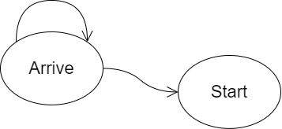
Scheduling as Directed Edge
Scheduling or triggering relationship between a pair of events shall be modeled as a directed edge
The origin event can be the same as the destination event
Note the style of the Arrow, need to differentiate it with other types of arrows in different graphs for this module
e.g., state graph, entity-flow diagram

Slide 5
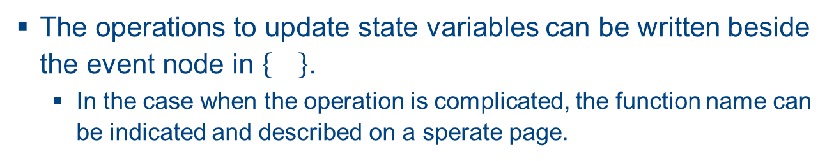


State Update (on Vertex)
The operations to update state variables can be written beside the event node in .
In the case when the operation is complicated, the function name can be indicated and described on a sperate page.
$$\left\{ f^{E1}\left(q\right) \right\}$$
$$\left\{s=s+1\right\}$$

Slide 6
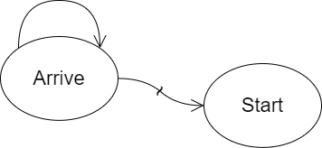

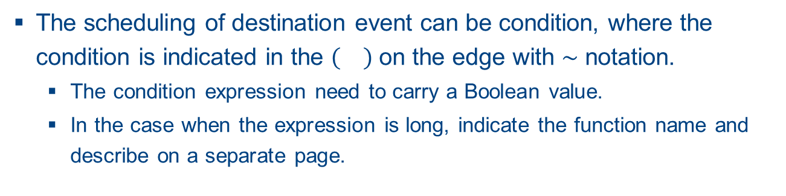



Condition (on Edge)
The scheduling of destination event can be condition, where the condition is indicated in the on the edge with $\sim$ notation.
The condition expression need to carry a Boolean value.
In the case when the expression is long, indicate the function name and describe on a separate page.
$c^{1}$: $s==0$
$$\left(c^{1}\right)$$
$$\left\{ f^{E1}\left(q\right) \right\}$$
$$\left\{s=s+1\right\}$$

Slide 7
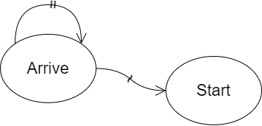




Time Delay (on Edge)
The scheduling of destination event can be on a future time, where the time delay is indicated on the edge with $=$ notation.
In the case when the expression is long, indicate the function name and describe it on a separate page.
$$t^{a}\sim T^{a}$$
$c^{1}$: $s==0$
$$\left(c^{1}\right)$$
$$\left\{ f^{E1}\left(q\right) \right\}$$
$$\left\{s=s+1\right\}$$

Slide 8
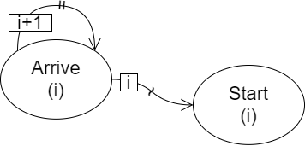




Parameterized Event Graph
Both event and scheduling relationship can be parameterized. Parameter is to be indicated on event vertex and on scheduling edge.
$$t^{a}\sim T^{a}$$
$c^{1}$: $s==0$
$$\left(c^{1}\right)$$
$$\left\{ f^{E1}\left(q\right) \right\}$$
$$\left\{s=s+1\right\}$$

Slide 9
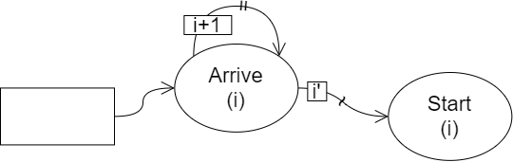


Initialize State Variables
The initial values of state variables can be specified in a rectangle box, with an arrow to schedule the initial events
$$t^{a}\sim T^{a}$$
$c^{1}$: $s==0$
$$\left(c^{1}\right)$$
$$q=0; \\ s=0$$
0
$$\left\{ f^{E1}\left(q, i\right) \right\}$$
$$\left\{s=s+1\right\}$$

Slide 10
Different Fidelity of Model for EG
Modelling with Event Graphs
Encapsulation into Activity
Different Fidelity of Model for EFD

Slide 11
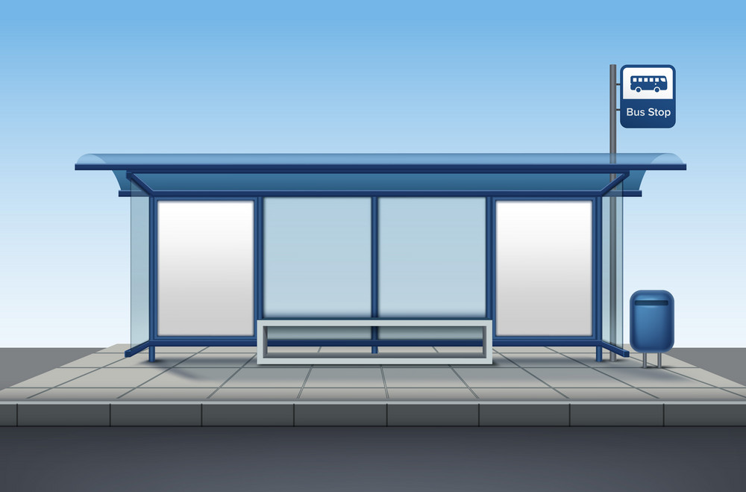
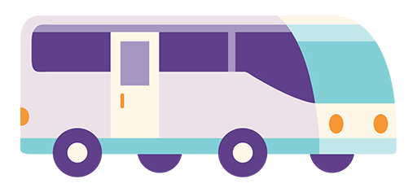
Example: Bus Stop (1 - Low fidelity)
Consider a bus stop where bus arrives in every 5 mins. If we are interested to study the total number buses arrived in a day, how many state variables and corresponding events are required?
1 state variable
1 event
Every 5 mins

Slide 12
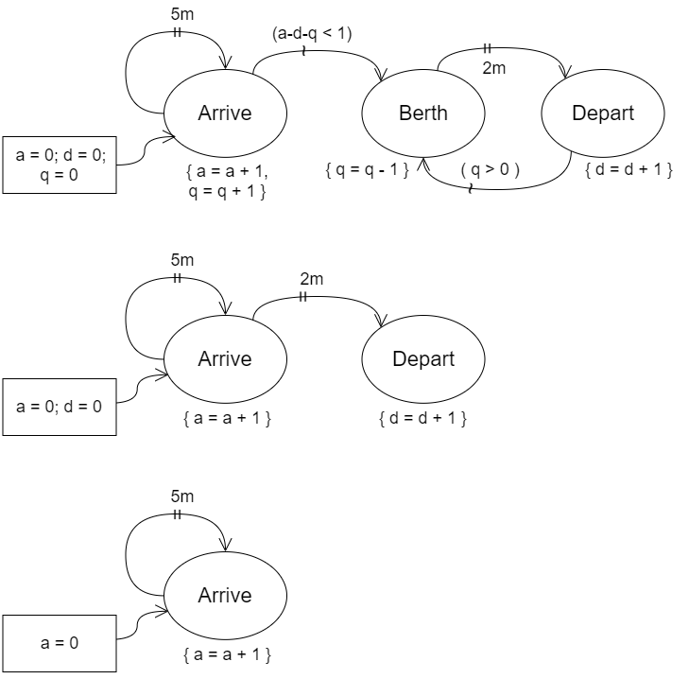
Bus Stop model implemented by EG (1)
Draw an event graph when only arrival of buses is the interest of study
Every 5 mins

Slide 13
Example: Bus Stop (2 - Mid fidelity)
What if the number of departed buses is also considered, assuming each bus will stay at bus stop for 2 minutes?
2 state variables
2 events
Every 5 mins
Stop for 2 mins

Slide 14
Bus Stop model implemented by EG (2)
Draw an event graph if both arrival and departure of buses are the interest of study
Every 5 mins
Stop for 2 mins

Slide 15
Example: Bus Stop (3 - High fidelity)
Assume the bus stop has only 1 berth, buses need to wait in a queue once the berth is occupied. How many state variables and events can you identify?
3 state variables
3 events
Every 5 mins
Stop for 2 mins

Slide 16
Bus Stop model implemented by EG (3)
Draw an event graph if limited space at berth is considered as well
Every 5 mins
Stop for 2 mins

Slide 17
Encapsulation into Activity
Modelling with Event Graphs
Different Fidelity of Model for EG
Different Fidelity of Model for EFD

Slide 18
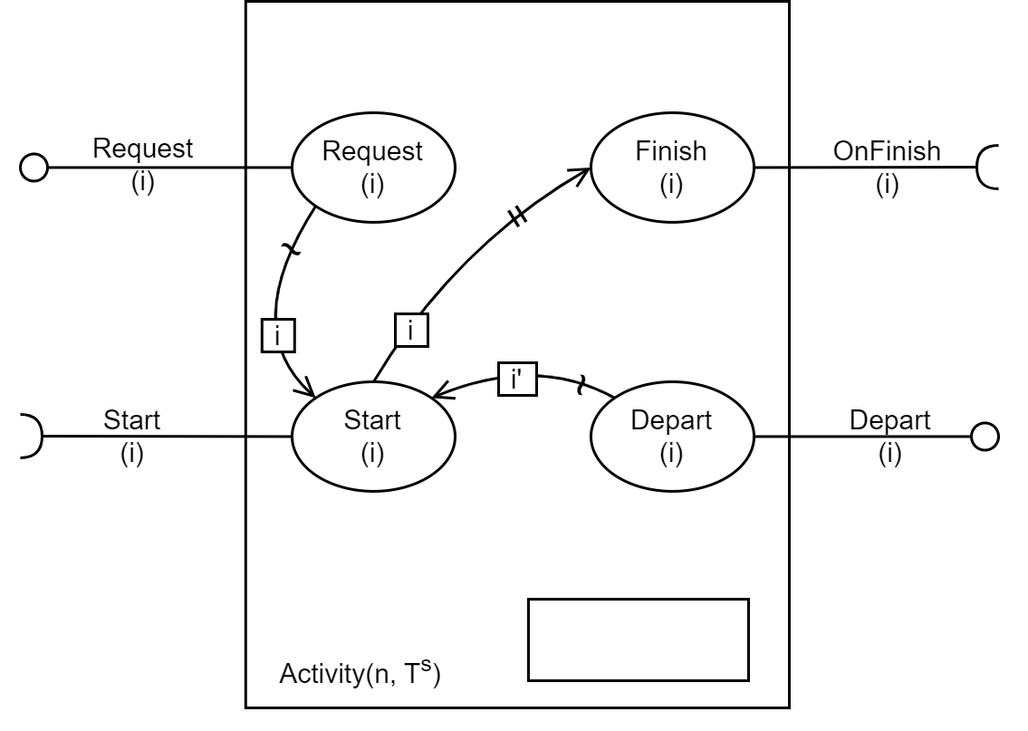
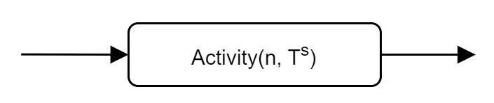

Modularized EG for an Activity (w/o info msg)
$$R=∅, A=∅, \\ P=∅$$

Slide 19
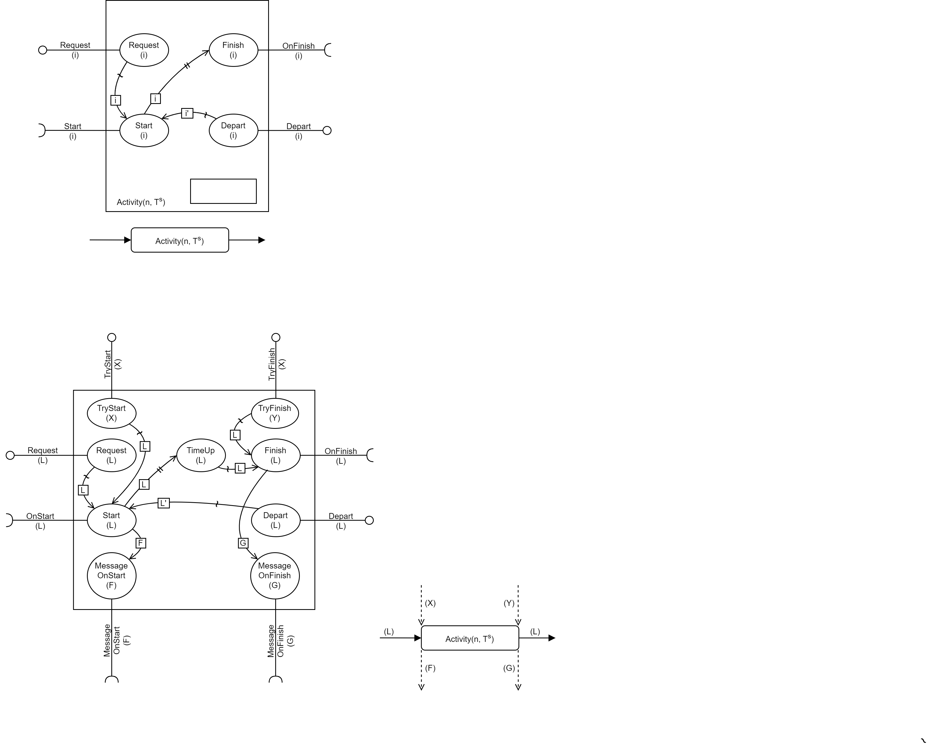
Modularized EG for an Activity (w info msg)
Y

Slide 20
Modelling with Event Graphs
Different Fidelity of Model for EG
Encapsulation into Activity
Different Fidelity of Model for EFD

Slide 21
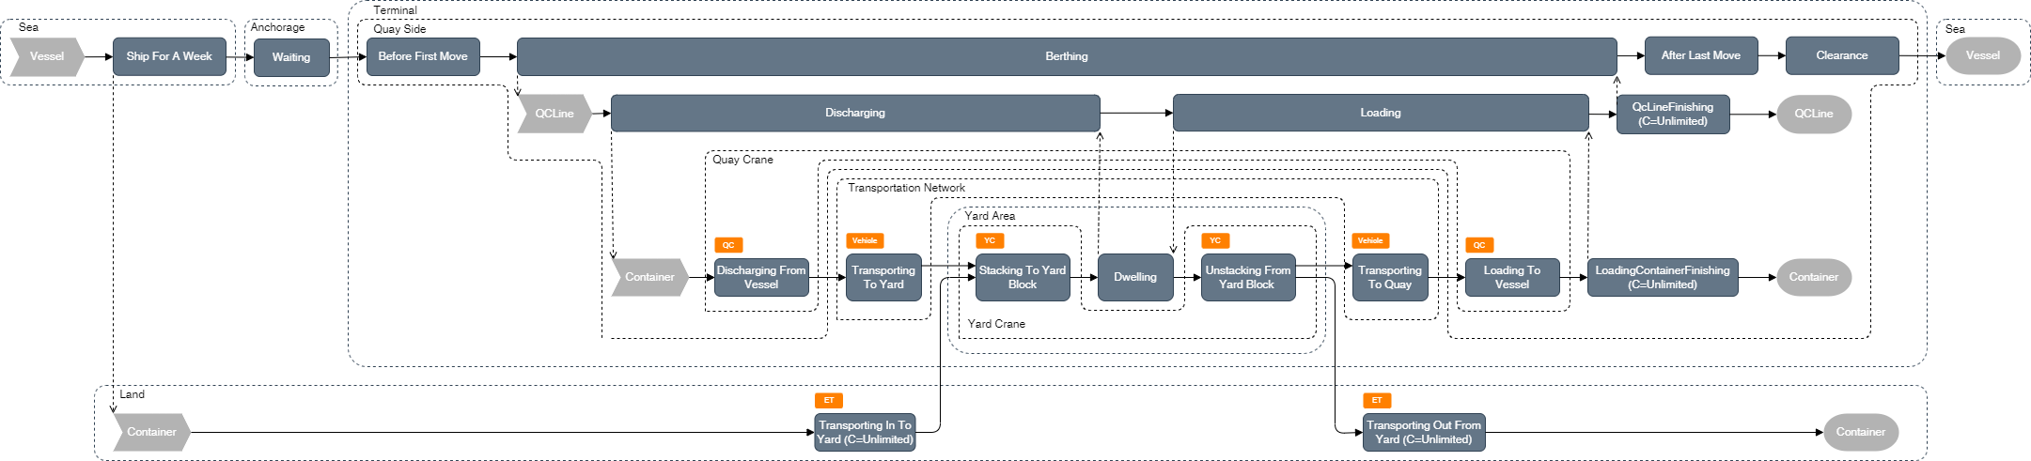
Lower fidelity model of terminal port

Slide 22
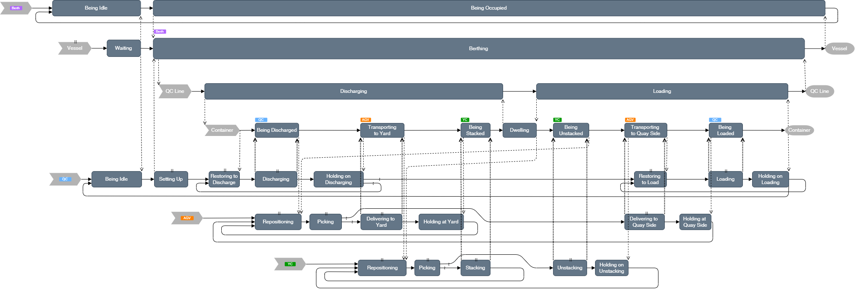
Higher fidelity model of terminal port

